Slide 1
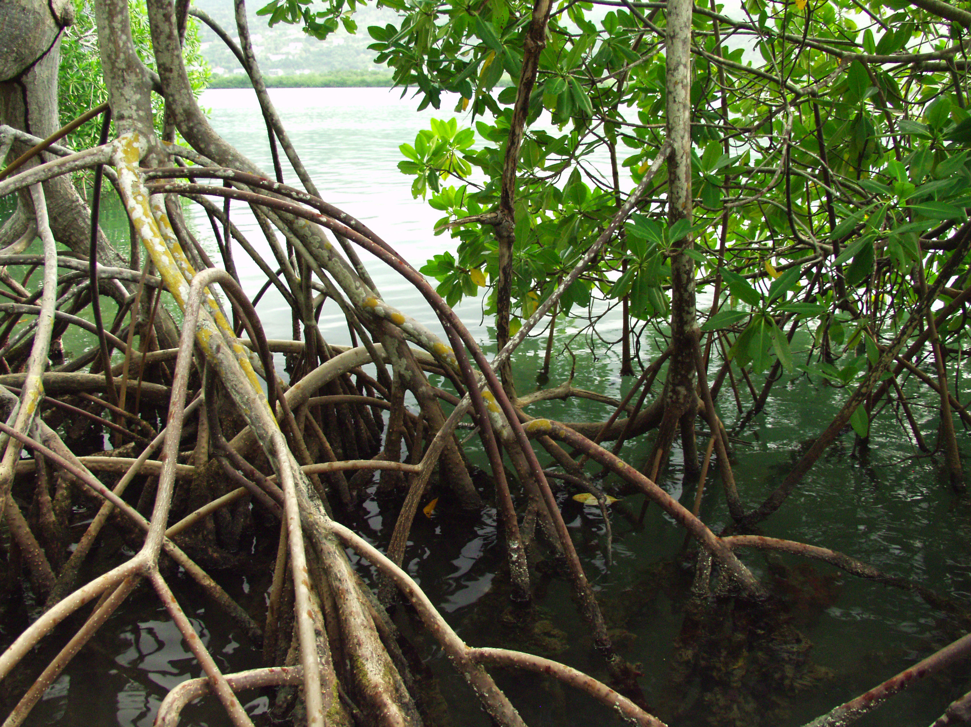
Montego River Mangrove Sanctuary
Bogue Lagoon Fish & Wildlife Sanctuary
MONTEGO BAY MARINE PARK
MANGROVE INITIATIVES

Slide 2
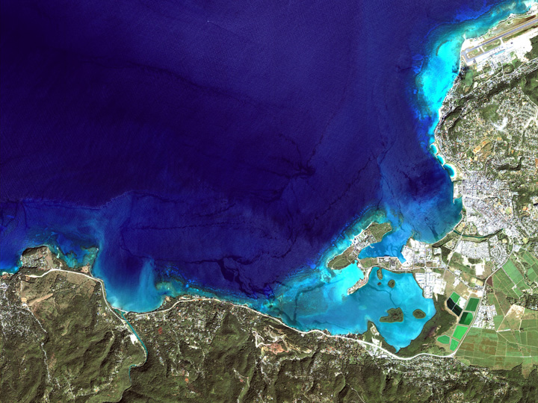

M O N T E G O B A Y M A R I N E P A R K

Slide 3
Bogue Lagoon
Fish and Wildlife Sanctuary

Slide 4
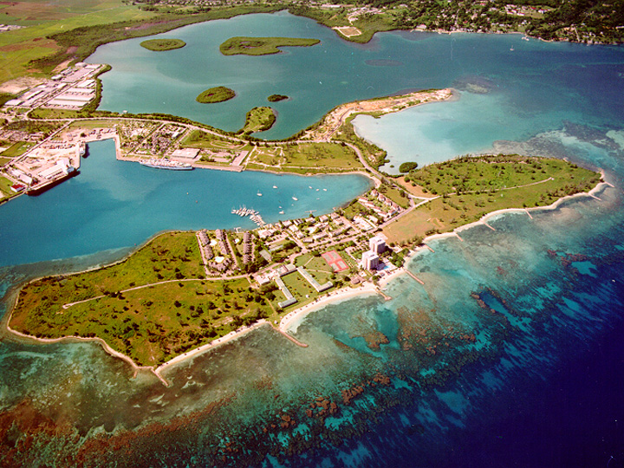
BOGUE LAGOON
FISH & WILDLIFESANCTUARY

Slide 5
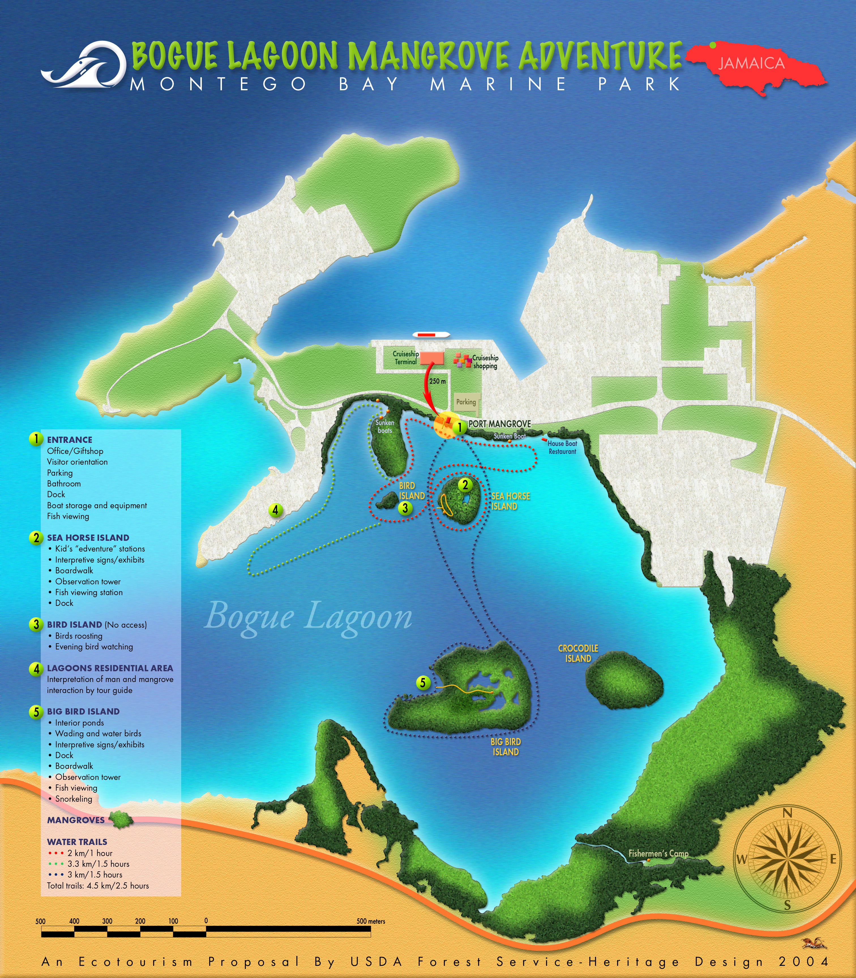
ENTRANCE
SEA HORSE ISLAND
BIRD ISLAND
LAGOONS
RESIDENTIAL AREA
BIG ISLAND

Slide 6
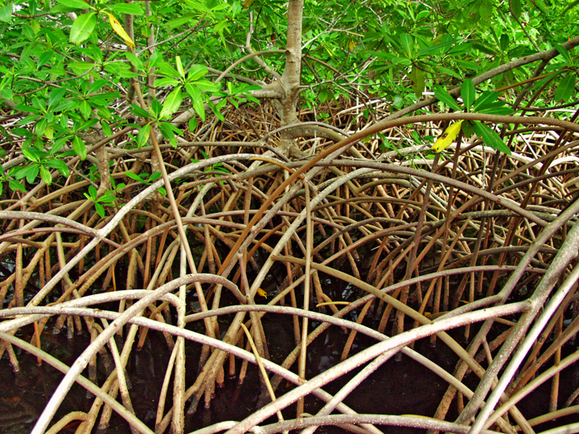
BOGUE LAGOON
MANGROVE ADVENTURE
GOALS:
• Mangrove protection
• Fish production
• Economic development
• Environmental education
• Support for MBMP
• Recreation enhancement
Public access

Slide 7
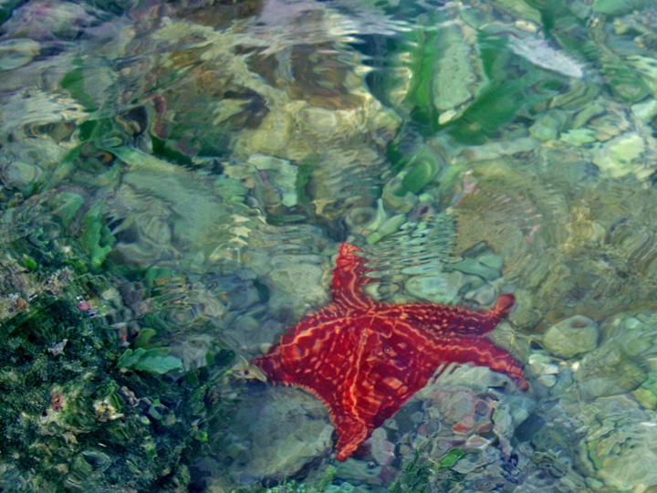
BOGUE LAGOON
MANGROVE ADVENTURE
OBJECTIVES:
• Jobs for fishermen
• Educational tours
• Recreational facilities
• Interpretation & visitor information
• Revenue for MBMP
• Management presence in Lagoon
• Community involvement

Slide 8
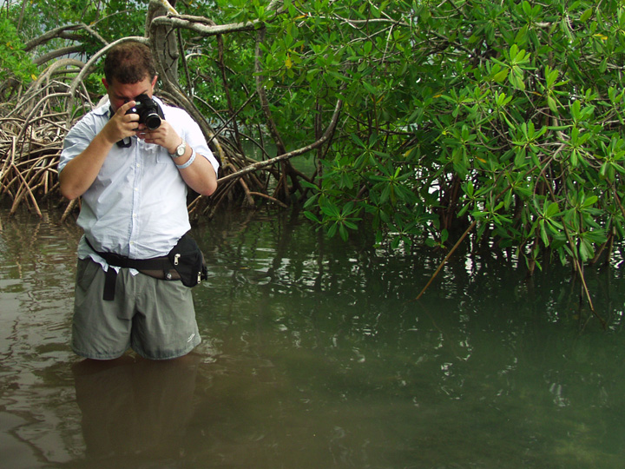
BOGUE LAGOON
MANGROVE ADVENTURE
ELEMENTS:
• Entrance facilities
• Guided kayak & boat tours
• Trained guides
• Docks
• Mangrove boardwalks
• Observation towers
• Fish viewing structures
• Interpretive signs & exhibits

Slide 9
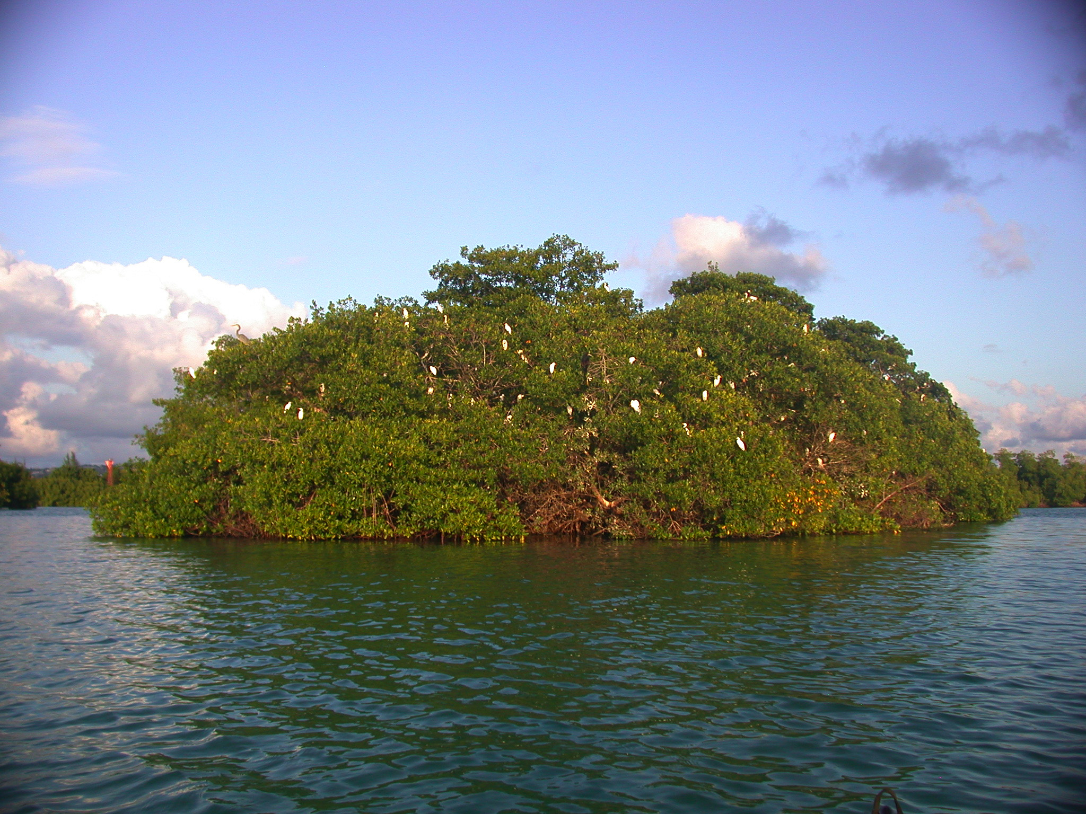
INTERPRETIVE OBJECTIVES
EMOTIONAL
• Appreciate mangroves
• Have fun in mangroves
• Lose fear of mangroves
• Mangroves are beautiful
INTELLECTUAL
• Understand how mangroves are important (at least 3 ways)
BEHAVIOURAL
• Get people into mangroves
• Tell friends about the experience
• Return again
• Purchase gifts
• Tip the tour guides
• Make donations to MBMP

Slide 10
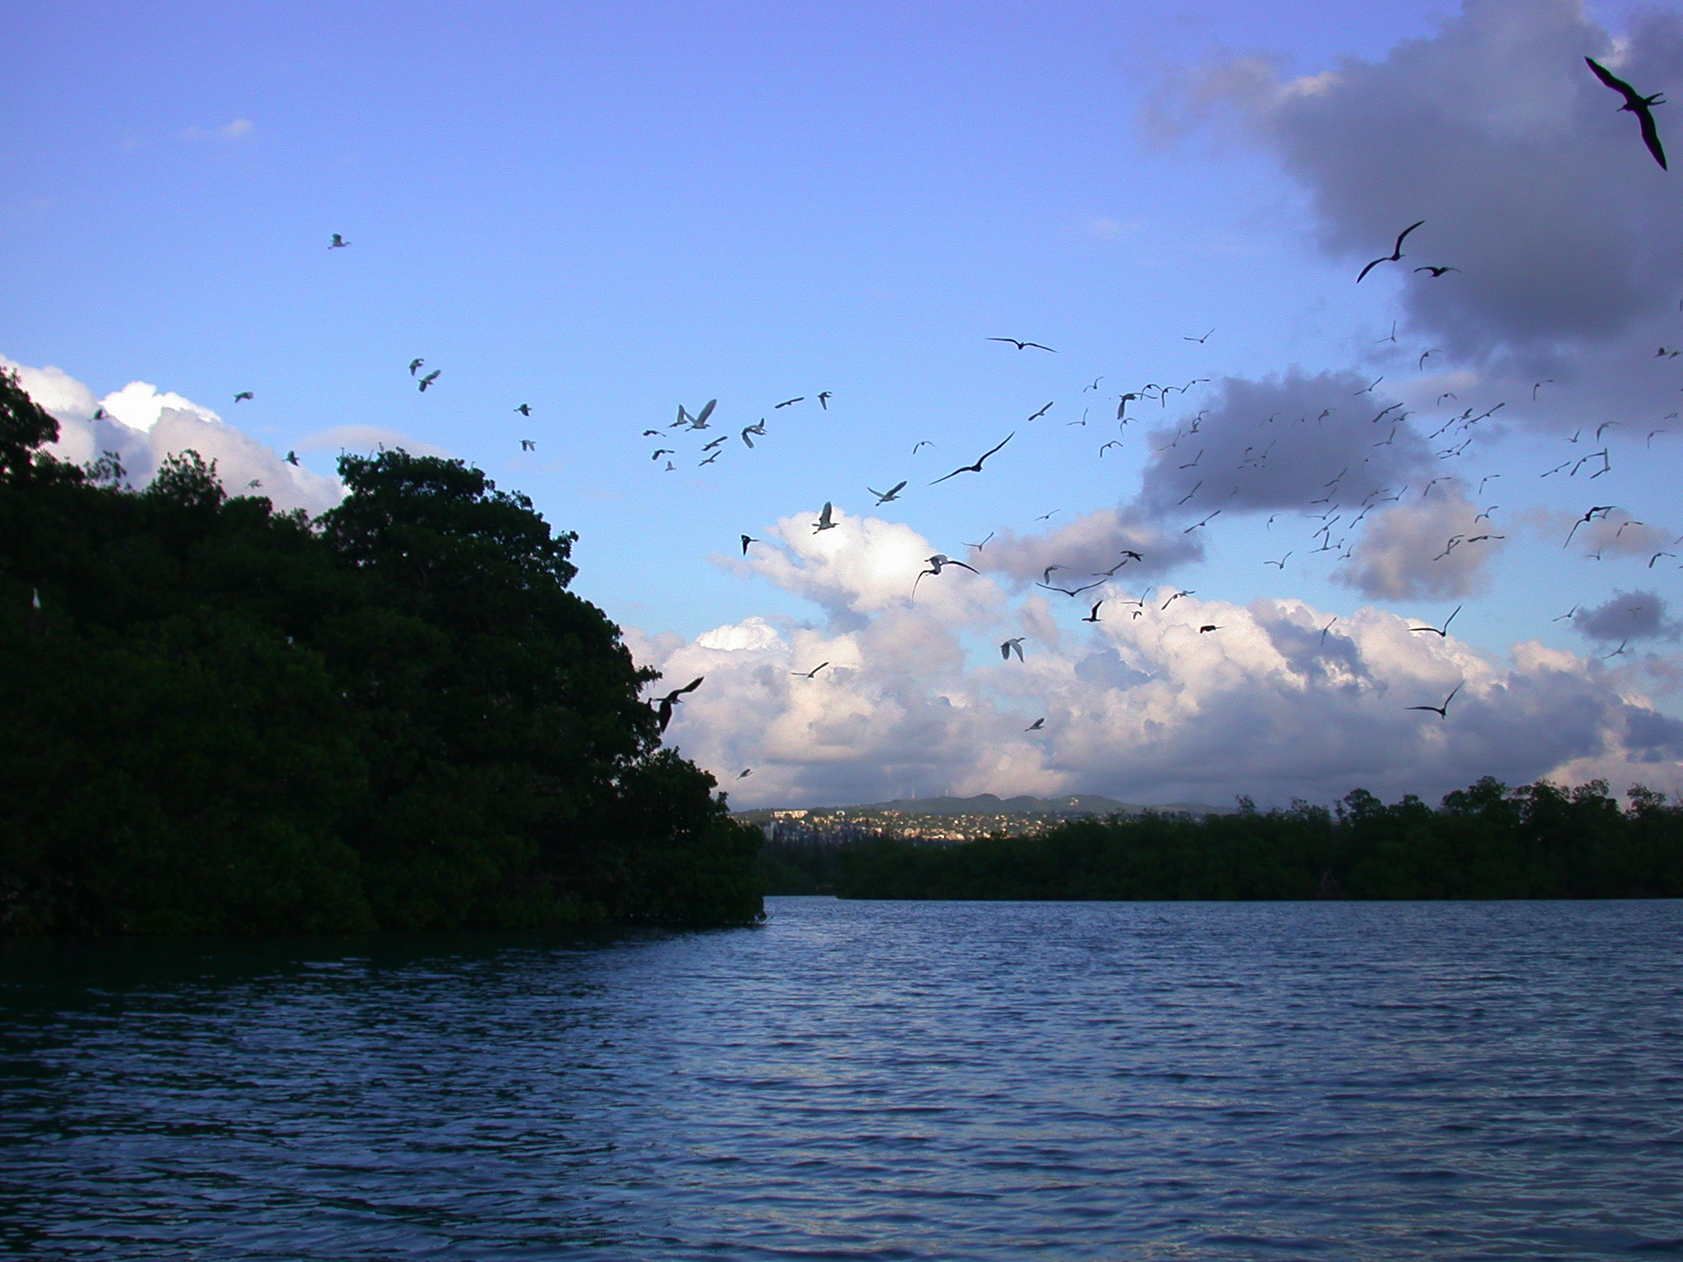
INTERPRETIVE MESSAGES
THEME (key message):
• Mangroves are good
SUB THEMES (to support the theme):
1. Mangroves protect us
2. Mangroves are a nursery for fish
3. Mangroves clean the water
4. Birds & mangroves work together

Slide 11
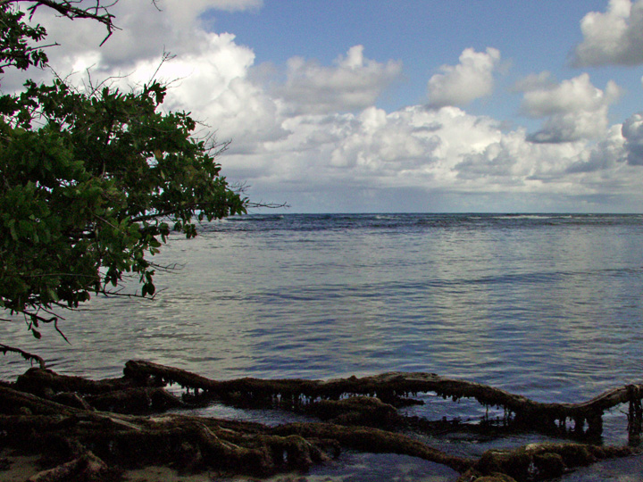
VISITOR ACTIVITIES
• Guided kayak & boat tours
• Personal interpretation
• Interpretive signs & exhibits
• Mangrove boardwalks
• Observation towers
• Gift shop
• Bird watching
• Fish viewing
• Snorkeling
• Kids’ interactive“Edventure”
• Facilities (ropes, suspension
bridge, ladders, etc.)
• Fly fishing

Slide 12
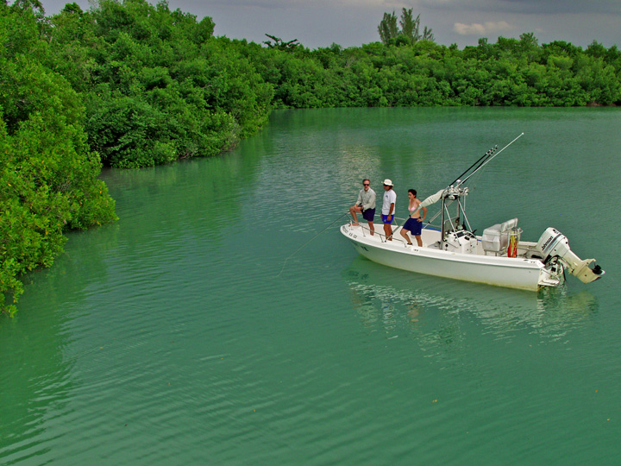
POTENTIAL MARKETS
• Local residents
• School children*
• Cruise ship visitors
• Hotel guests
*Kids require special interpretive programs

Slide 13
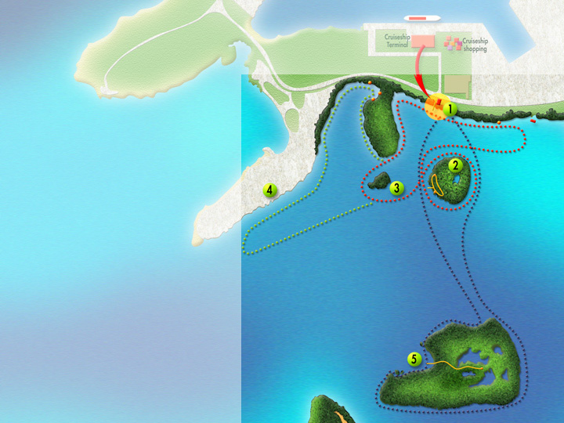
PROPOSED VISITOR FACILITIES
1. ENTRANCE
• Parking
• Office/gift shop
• Interpretation &
visitor information
• Environmental toilets
• Sheltered staging area
• Dock
• Equipment storage
• Equipment washing
• Kayaks & powerboats

Slide 14
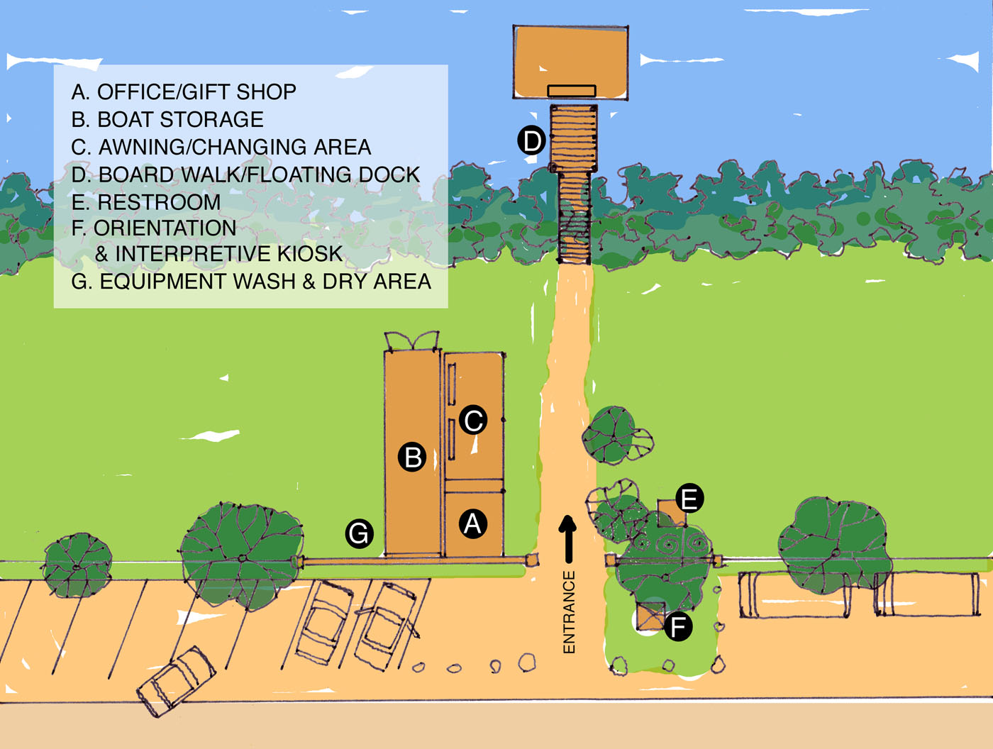
ENTRANCE
PLAN MAP

Slide 15
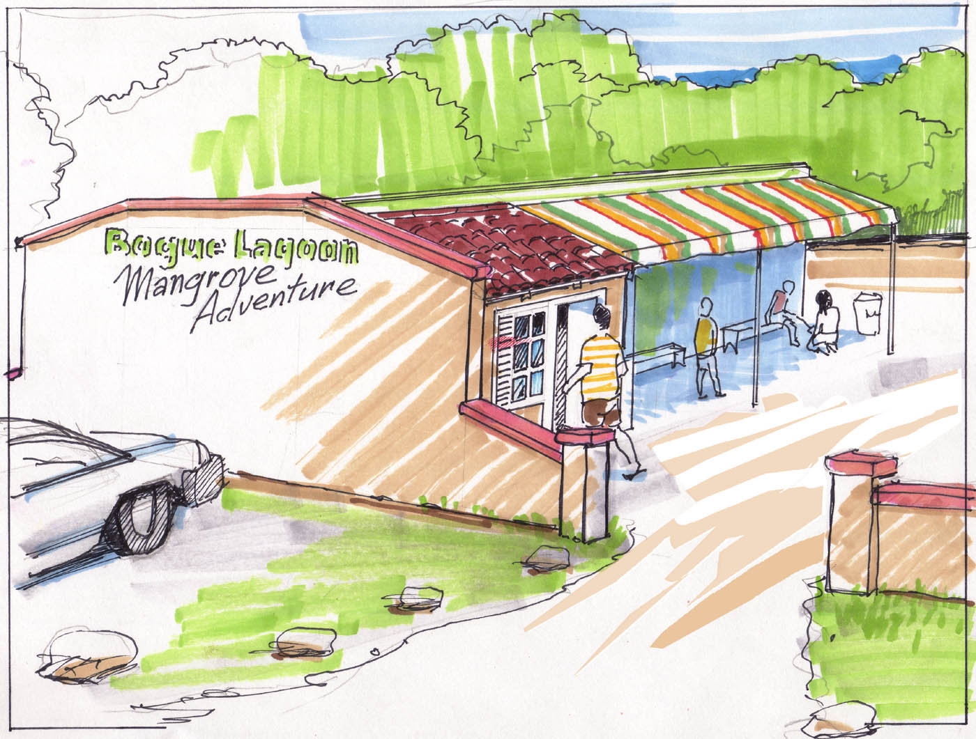
ENTRANCE
Kayak Tours
Boat Tours
Mangrove Islands
Bird Watching
Fly Fishing
Fish Viewing

Slide 16
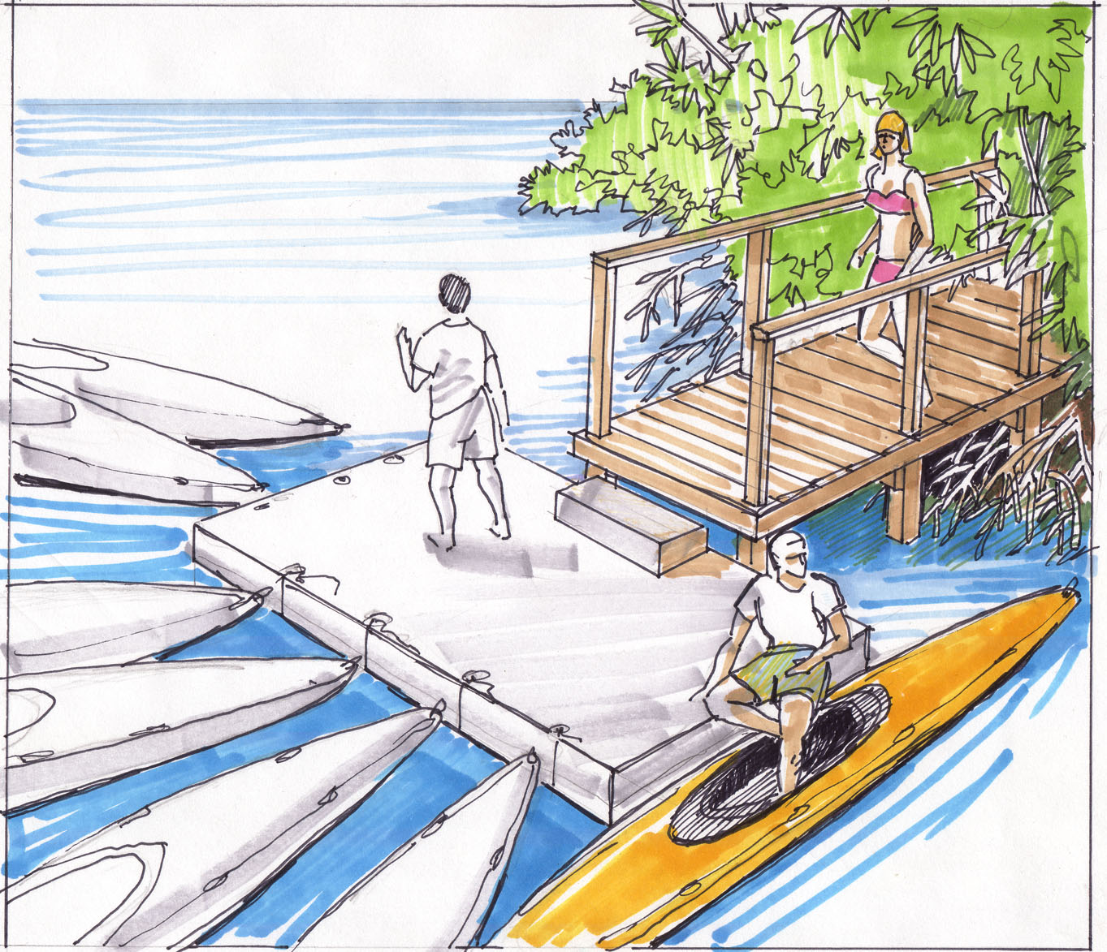
DOCKING
FACILITIES

Slide 17
PROPOSED VISITOR FACILITIES
2. SEA HORSE ISLAND
• Dock or shallow water
landing
• Mangrove boardwalk
• Fish viewing station
• Observation tower
• Interactive “Edventure” facilities
-Rope swing
-Suspension bridge
-Ladders

Slide 18
PROPOSED VISITOR ATTRACTIONS
3. BIRD ISLAND
• Roosting birds
• No access
4. LAGOONS HOMES
• Interpret Man-
Mangrove interactions

Slide 19
PROPOSED VISITOR ATTRACTIONS
5. BIG ISLAND
• Interior ponds
• Wading & water birds
• Dock
• Mangrove boardwalk
• Observation tower
• Snorkeling south side

Slide 20
PROPOSED KAYAK TRAILS
Bird Is., Sea Horse Is. & house boat = 2km/1hr
Same as #1 plus Lagoon homes = 3.3km/1.5 hrs
Bird Is., Sea Horse Is. & Big Is. = 3km/1.5 hrs
All of the above = 4.5km/2.5 hrs

Slide 21
BOGUE LAGOON KAYAKING
Compares well with other destinations:
20 points Culebra Is., Puerto Rico
19-20 points Bogue Lagoon, Jamaica
19 points Glover’s Reef, Belize
Numerical rankings based on fauna, water, scenery, safety, cultural & natural attraction, paddling diversity, other recreation opportunities, user conflicts, accessibility, & trash.

Slide 22
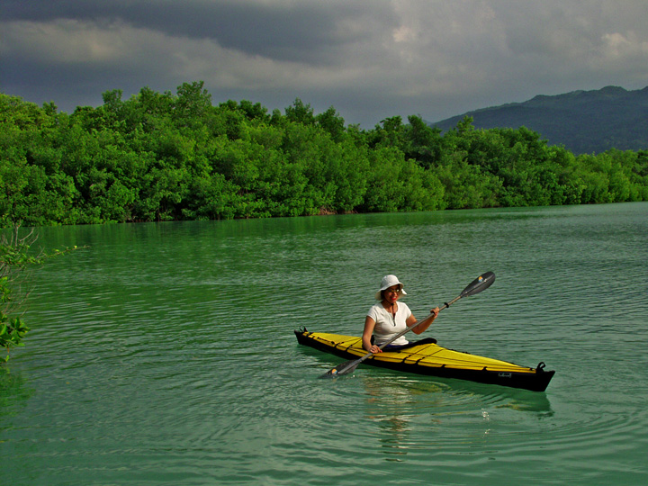
ADVANTAGES OF KAYAKS
OVER CANOES
• Faster to learn and easier to operate (more fun)
• Safer, more stable and easier to get on/off
• Less expensive and cheaper to ship
• Easier to handle in cross wind
• More maneuverable
• Easier to stack for storage
• Do not fill with water if capsized

Slide 23
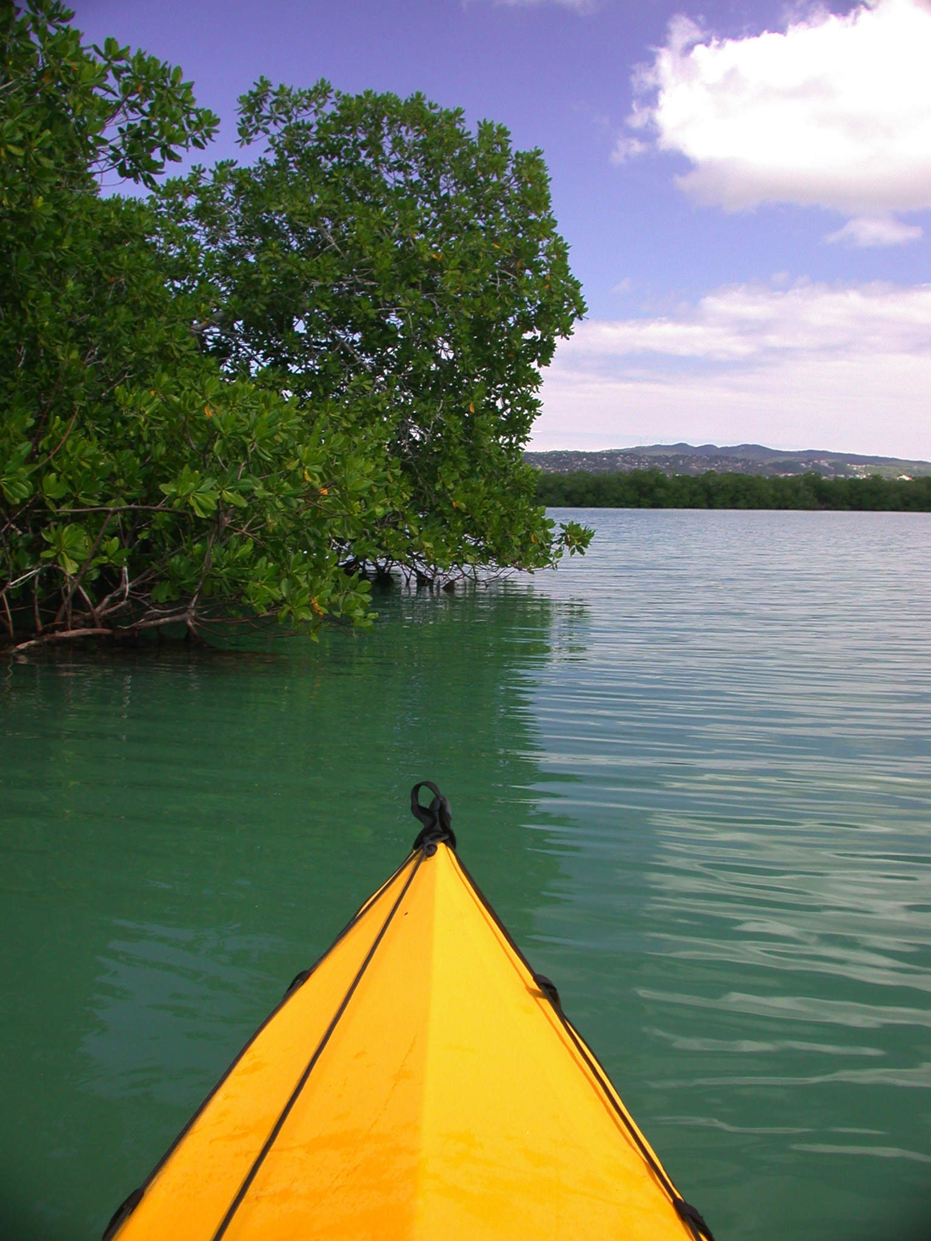
KAYAKS & EQUIPMENT
10 sit-on-top kayaks for guests (8 singles, 2 doubles)
2 sit-on-top professional kayaks for guides
15 paddles
20 life jackets for guests
2 professional life jackets for guides (special safety features)
20 pair water shoes
2 first aid kits
Waterproof binoculars, headlamps, flashlights, & dry bags
2-way radios
Masks & snorkels

Slide 24
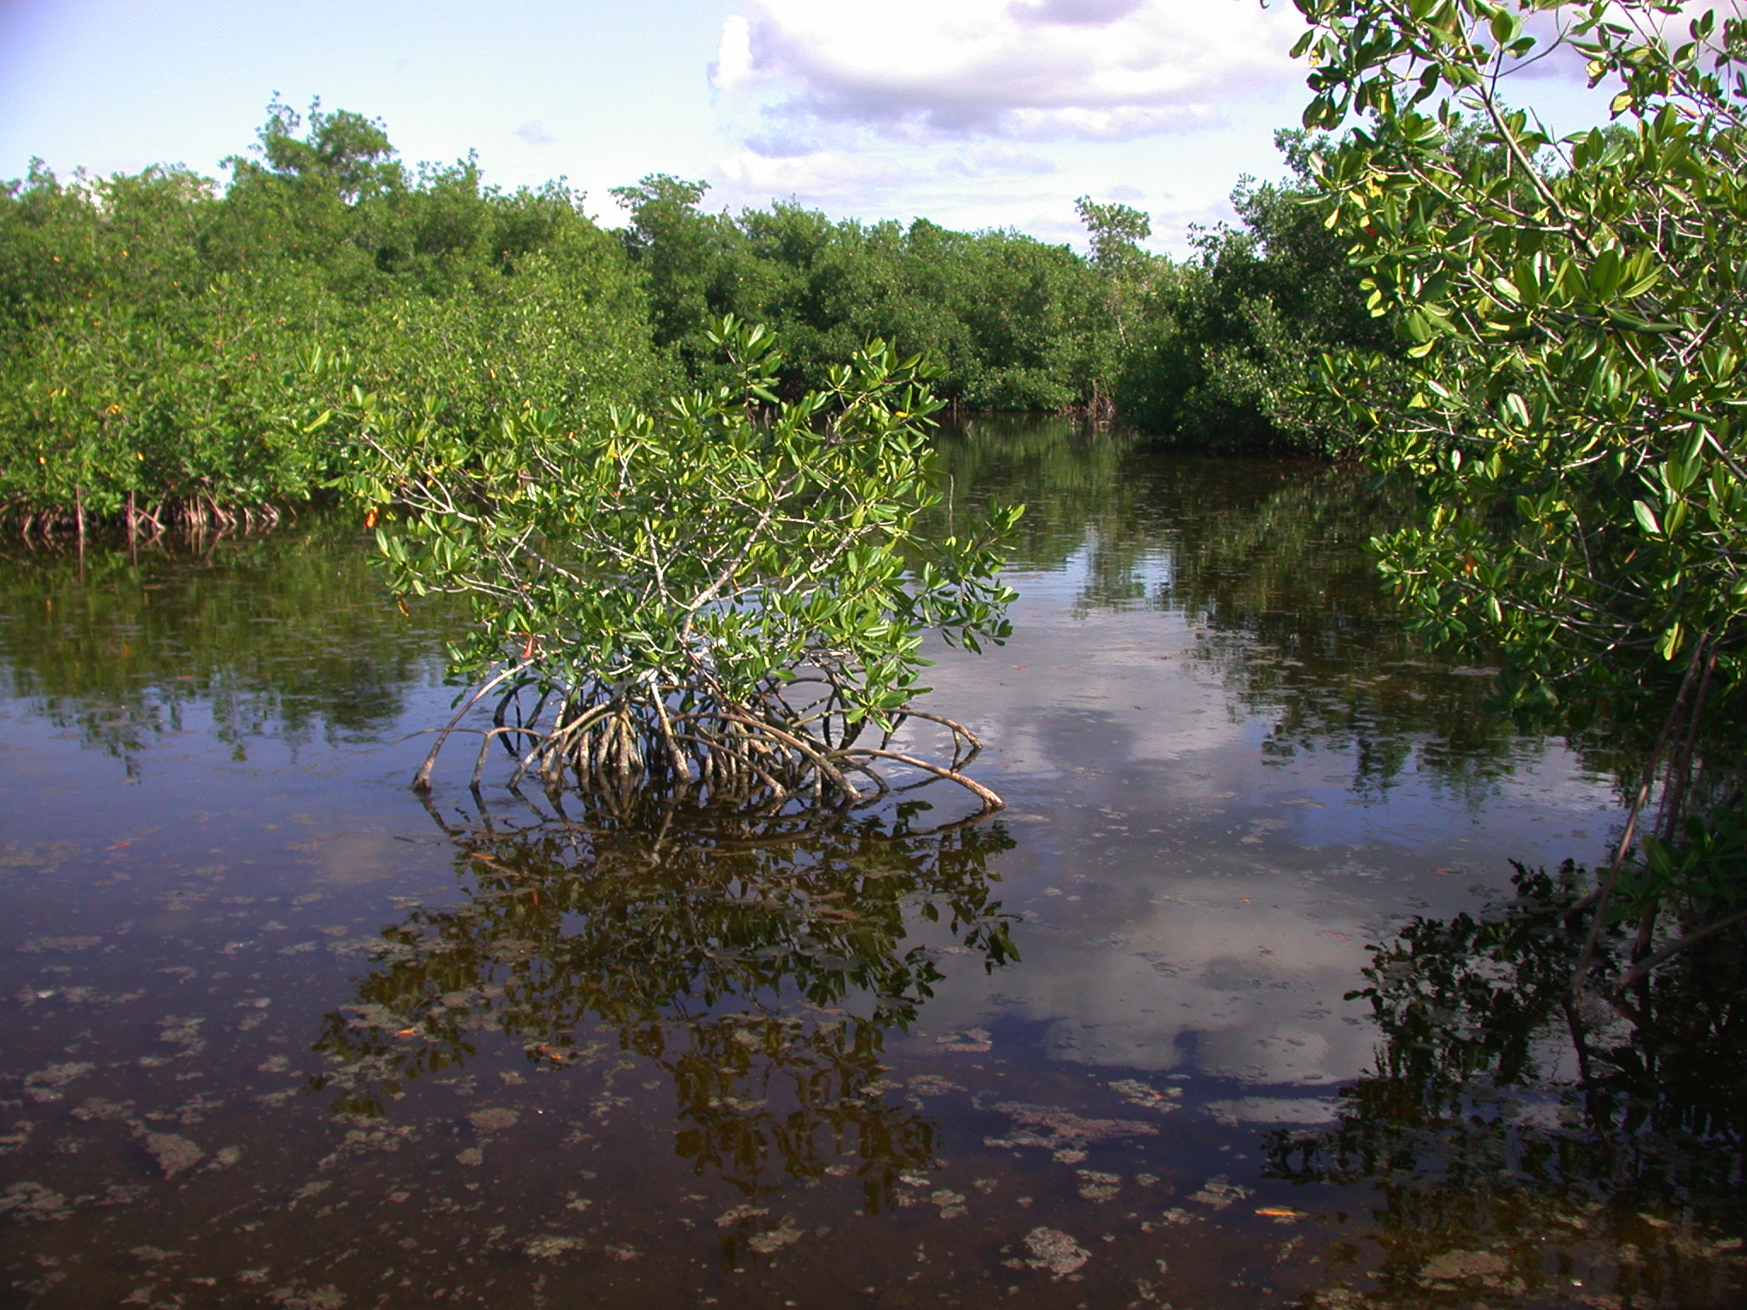
STEPS
PHASE 1
• Site plan & design for entrance facilities
• Overall interpretive plan for entire Lagoon
• Order kayaks & equipment
• Interpretive design for kiosk & plastic identification cards
• Develop marketing materials
• Construct entrance facilities
• Manufacture & install interpretation at entrance
• Print plastic identification cards (map, birds, fish)
• Develop interpretive presentations for water tours
• Train guides

Slide 25
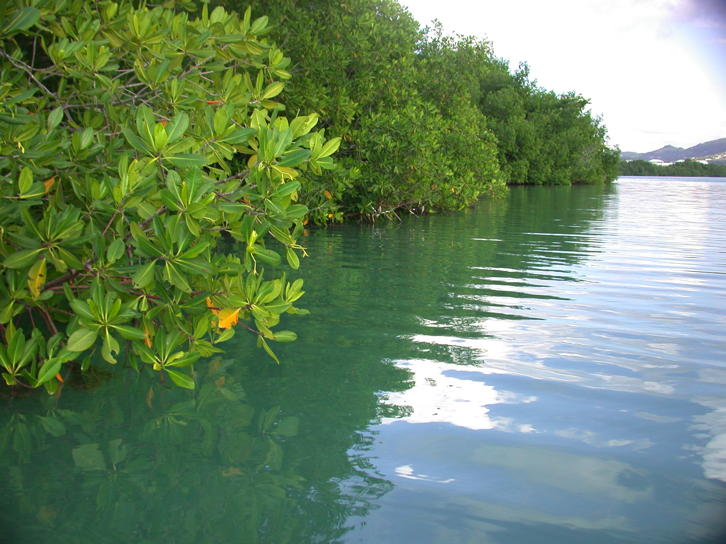
STEPS
PHASE 2 – ISLANDS
• Site plans & designs for Sea Horse & Big Bird Island
mangrove boardwalks, viewing towers, docks, etc
• Designs for interpretive signs
• Develop presentations for guided tours
• Construct facilities on islands
• Manufacture & install interpretive signs
• Train guides for interpretive tours on the islands

Slide 26
